Slide 1
Excel Power Tools
Microsoft Research
Windows Azure for Research Training

Slide 2
Excel Power Tools
Learning objectives – what you will learn:
Designing data analysis services that can be viewed from Excel or the browser
Power Pivot – analytics
Power Map – geospatial
Power View – visualization
Power Query – discovery, query, transformation and mashup
Others
Examples of when this is useful for research scientists

Slide 3
Agenda
Excel Power Tools (Pivot, Map, View, Query)
LayerScape – MSR Visualization Tool
Data Nitro – Python + Excel

Slide 4

Big Data Tools
PowerPivot
(Excel)
Self-Service Analytics
Power Query
(New)
self-service data discovery, query, transformation and mashup
Data Market Place
Excel on HPC Cluster
StreamInsight
Complex Event Processing
PowerView
(Excel2013)
Data Visualization
PowerMap
(New)
Data Visualization
Microsoft Distribution of Hadoop
Notes:
Key point – MS big data solution is more than just Hadoop

Slide 5
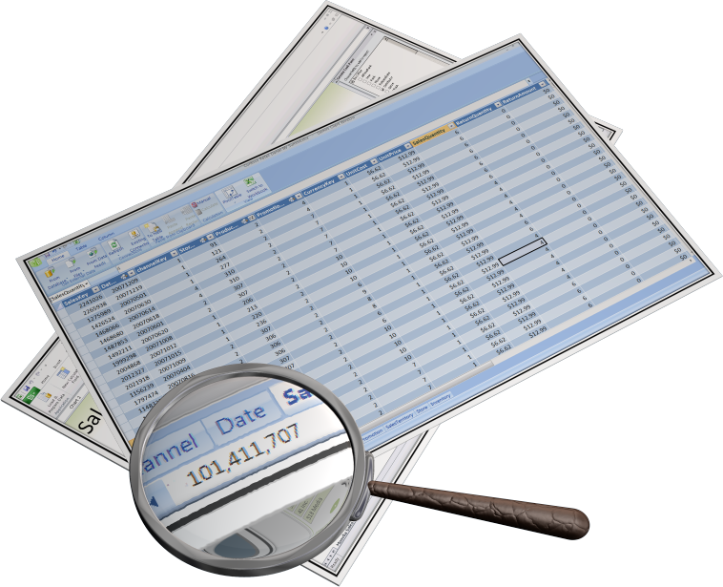
What is PowerPivot?
Create compelling self-service “business intelligence” (BI) solutions - transform raw data into meaningful and useful information
Using Familiar Excel Interface
BI Semantic Model
In memory compressed column store
Sophisticated Time Intelligence
Mashups
Research scientists can benefit too

Slide 6
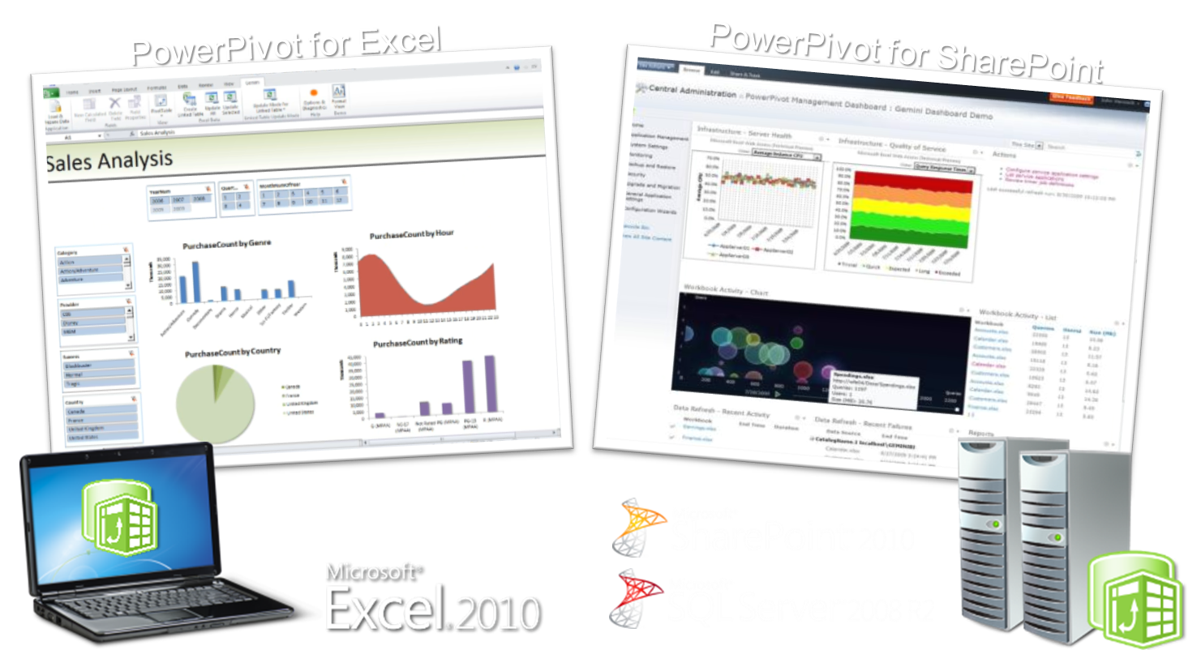
PowerPivot Versions

Slide 7
What is Power View?
Power View is an interactive data exploration and visual presentation experience

Slide 8






SharePoint Architecture
SharePoint Farm
SQL Server BIDS
BISM Model
Web Front End
App Server
SSRS Addin for SharePoint
RS Shared Service
Power View via Browser
AS Server
PowerPivot
System Service
PowerPivot
Web Service
Analysis Services SP Integrated
Excel PowerPivot
Model
Data sources

Slide 9







IT Pros
Power Users
Developers
End Users
Sophisticated Design Environment
Productive Authoring
Visual data representation
Report Viewer Controls
Re-use of insights
Highly Interactive
Rich Design Capabilities
Flexible layout
Rich Presentation
Report Designer / SSRS
Power Pivot
Power View
Embedded Operational Business

Slide 10
PowerPivot, Power View Demo
Notes:
1 – simple Example
2 – Real world – KINECT!

Slide 11
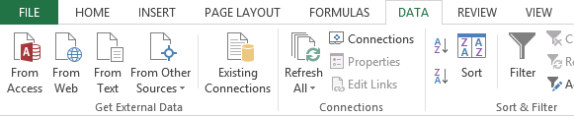
Current State of the Art

Slide 12
The Data tab – the old way

Slide 13
Modern experiences for getting data

Slide 14
Why Power Query?
Enable self-service data discovery, query, transformation and mashup experiences for Information Workers, via Excel and PowerPivot
Search, Discover, and connectivity to a wide range of data sources, including publicly available data of all sizes & shapes.
Highly interactive and intuitive experience for rapidly and iteratively building queries over any data source, any size.
Consistency of experience, and parity of query capabilities over all data sources.
Joins across different data sources; ability to create custom views over data that can then be shared with team/department.

Slide 15
Connecting Excel and Hadoop on Windows Azure

Slide 16
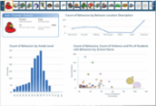
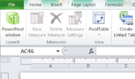
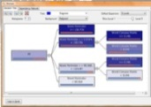
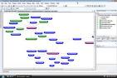
Microsoft Big Data Solution
FAMILIAR END USER TOOLS
Power View
Excel with PowerPivot
Predictive Analytics
Embedded BI
BI PLATFORM
SSAS
SSRS
Microsoft EDW
Connectors
Hadoop On Windows Azure
Hadoop On Windows Server
UNSTRUCTURED & STRUCTURED DATA
Sensors
Devices
Bots
Crawlers
ERP
CRM
LOB
APPs

Slide 17
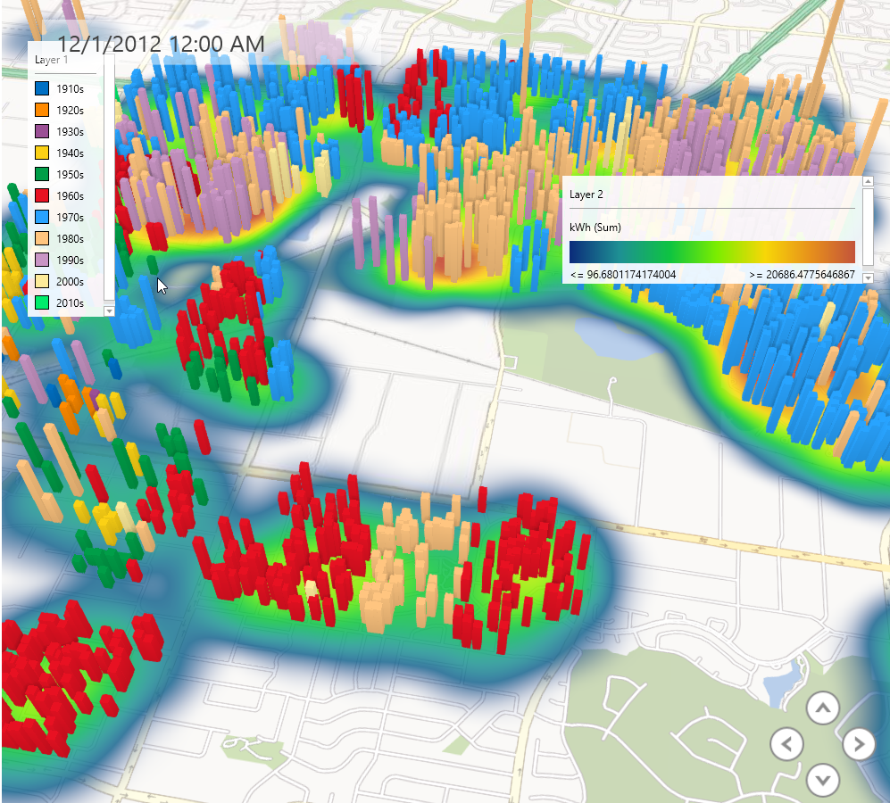
PowerMap

Slide 18
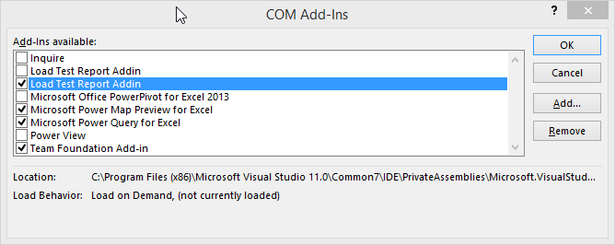
Enable your power tools

Slide 19
Scaling Excel Compute with Windows HPC Server and Windows Azure

Slide 20
Example Models and Markets outside of Research
Insurance
Reserve requirements calculation
Data sets from 1000’s to 1 million
4 weeks to calculate (on a monthly schedule)
HPC solution:
Full calculation in 24 hours
Financial
Trade re-pricing
Overnight/cross-market
Est. 4 hours for a subset of trades
HPC Solution
Subset of trades in ~5 minutes
Notes:
Two use cases that demonstrate the dramatic reduction in run time.

Slide 21
Three Ways to Scale out Excel Compute on Windows HPC Server and Windows Azure
Connects to the cluster as a SOA client
VSTO code in workbook calls out to SOA Service
Input and output managed by Excel developer
Run multiple instances of Excel 2010 on an HPC Cluster
Each instance runs an iteration of the same workbook
Can be launched from Excel 2010 or a Windows program
Excel Dialog Suppression
Run User Defined Functions in parallel on a cluster
Excel 2010 includes a new API and options for HPC cluster
Support for .XLL files developed through Excel SDK
Easy to develop on a desktop and deploy to a cluster
Excel SOA Client
Excel workbooks on the Cluster (not yet on Azure)
Excel UDF on the Cluster
Notes:
How do we do this? We provide 2 new ways for Excel to talk to an HPC Server

Slide 22
Supporting Disconnected Clients
Broker
Node
Broker Service
SOA Client
Broker
Compute Node
Store
Get Broker Node list
Head Node
Session Handler
Http or Net.Tcp

Slide 23
Running Hedging Calculation using Excel + Cloud Compute Engine Demo
Notes:
1 – simple Example
2 – Real world – KINECT!

Slide 24
HPC and Excel Resources
DocumentationUnder ‘Featured Content’ on TechNet.
On the Download center
Building VBA applications
Building a custom client and service
Building a SOA .Net application
Converting cluster-safe UDFs for Offloading
HPC V4 Sp1

Slide 25
References
Power Query: http://www.microsoft.com/en-us/download/confirmation.aspx?id=39379
Power Map: http://www.microsoft.com/en-us/download/details.aspx?id=38395

Slide 26
Excel Power Tools
Learning objectives – what we have learned:
Designing data analysis services that can be viewed from Excel or the browser
Power Pivot – analytics
Power Map – geospatial
Power View – visualization
Power Query – discovery, query, transformation and mashup
Others
Examples of when this is useful for research scientists

Slide 27
© 2013 Microsoft Corporation. All rights reserved. Microsoft, Windows, Windows Vista and other product names are or may be registered trademarks and/or trademarks in the U.S. and/or other countries.
The information herein is for informational purposes only and represents the current view of Microsoft Corporation as of the date of this presentation. Because Microsoft must respond to changing market conditions, it should not be interpreted to be a commitment on the part of Microsoft, and Microsoft cannot guarantee the accuracy of any information provided after the date of this presentation. MICROSOFT MAKES NO WARRANTIES, EXPRESS, IMPLIED OR STATUTORY, AS TO THE INFORMATION IN THIS PRESENTATION.

